Slide 1
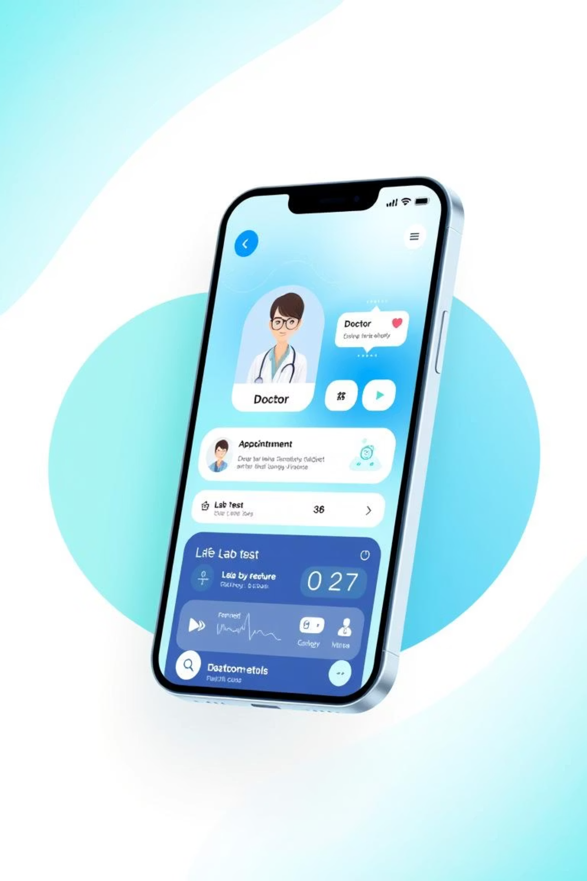
24x7 HealthCare – Android App
Welcome to the presentation on the 24x7 HealthCare Android App. This project explores developing a mobile healthcare service.
Team Stackmob
Miruthula s.k 22bce1949 CSE (core) Btech
Rohith.s 22bce1872 CSE (core) Btech
Yaswanth sai.D 22BCE1882 CSE (core) Btech
Guduri Dhanush 22BCI0223 CSE (Information Security) Btech
Madhav Aithagani 22bds0031 CSE (Data science) Btech
D.Yaswanth Sai 22BCI0215 CSE (Information security) Btech

Slide 2


Objective of the Project
Seamless Healthcare Access
Patient Convenience & Control
Offer a unified platform for healthcare services. Users can manage health tasks with ease.
Empower users to find doctors and book appointments. Order lab tests and review history easily.
Efficiency & Reduced Wait Times
Promote efficient patient-service interaction. Minimize physical visits and long queues.

Slide 3
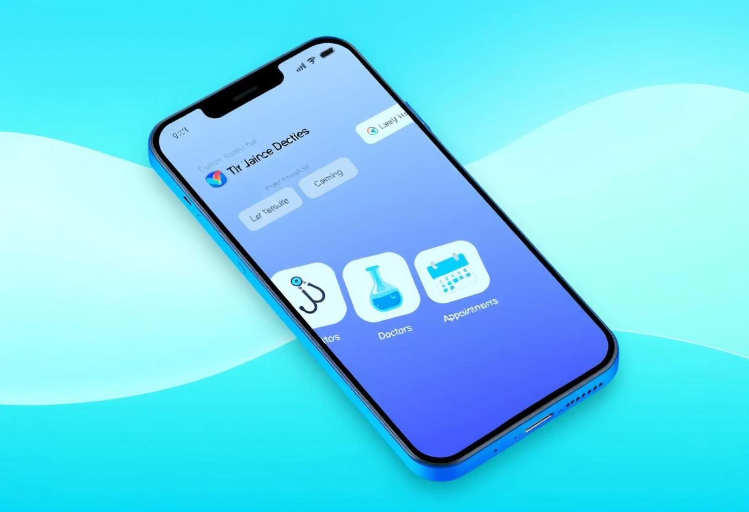
App Overview
The 24x7 HealthCare app provides an intuitive user experience. Users can register or log in to access the dashboard. The home screen offers quick access to main features.
Doctor listings, lab tests, appointments, and orders are easily accessible. Each section uses a dedicated Activity for modularity. The process is streamlined and user-friendly.

Slide 4
Technology Stack
Native Android Development
Built using standard Android tools.
Java for Logic
Primary language for business logic and backend.
XML for UI
Front-end layouts and components.
SQLite for Storage
Handles local data, enables offline use.
RecyclerViews for Lists
Displays dynamic lists like doctor profiles.
Intents for Navigation
Manages transitions between Activities.

Slide 5
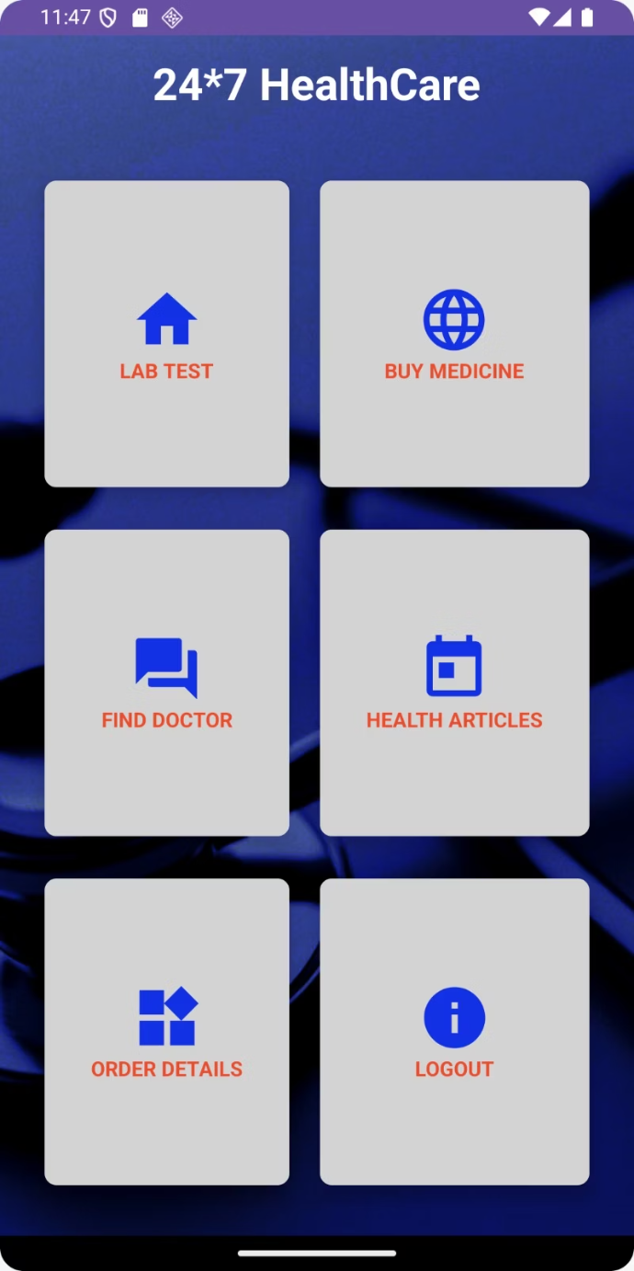
Home Dashboard
The Home Dashboard is the app's central control panel. It displays a welcome message with the user's name. Clickable icons provide quick access to key features.
Features include doctors, lab tests, and appointments. Easy logout and session handling are also available.
Technologies Used:
HomeActivity.java (dashboard logic)
activity_home.xml (UI layout)
SQLite (fetches user info)

Slide 6
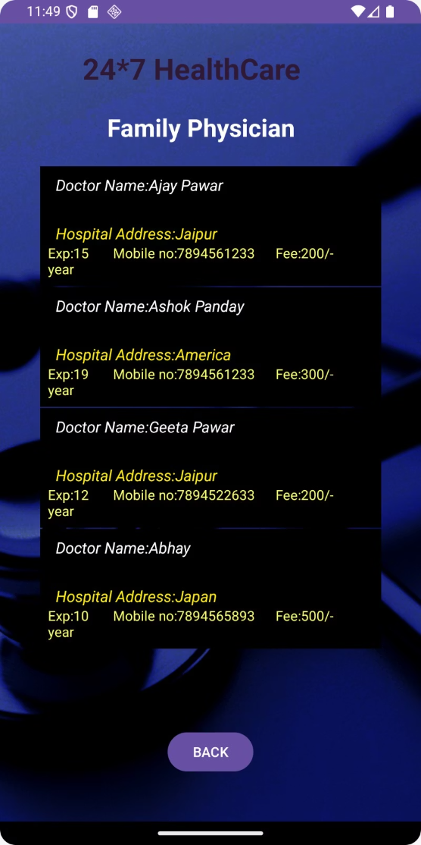
Lab Test Packages
The Lab Test Packages section lists available tests. Each card presents the test name, price, and details. Users can add tests to their local SQLite cart.
This allows for checkout preparation, even offline. The design uses a deep blue to convey reliability.
Technologies Used:
LabTestActivity.java (listing and carting)
activity_lab_test.xml (list layout)
CustomAdapter.java (binds test data)
SQLite (stores selected packages)

Slide 7
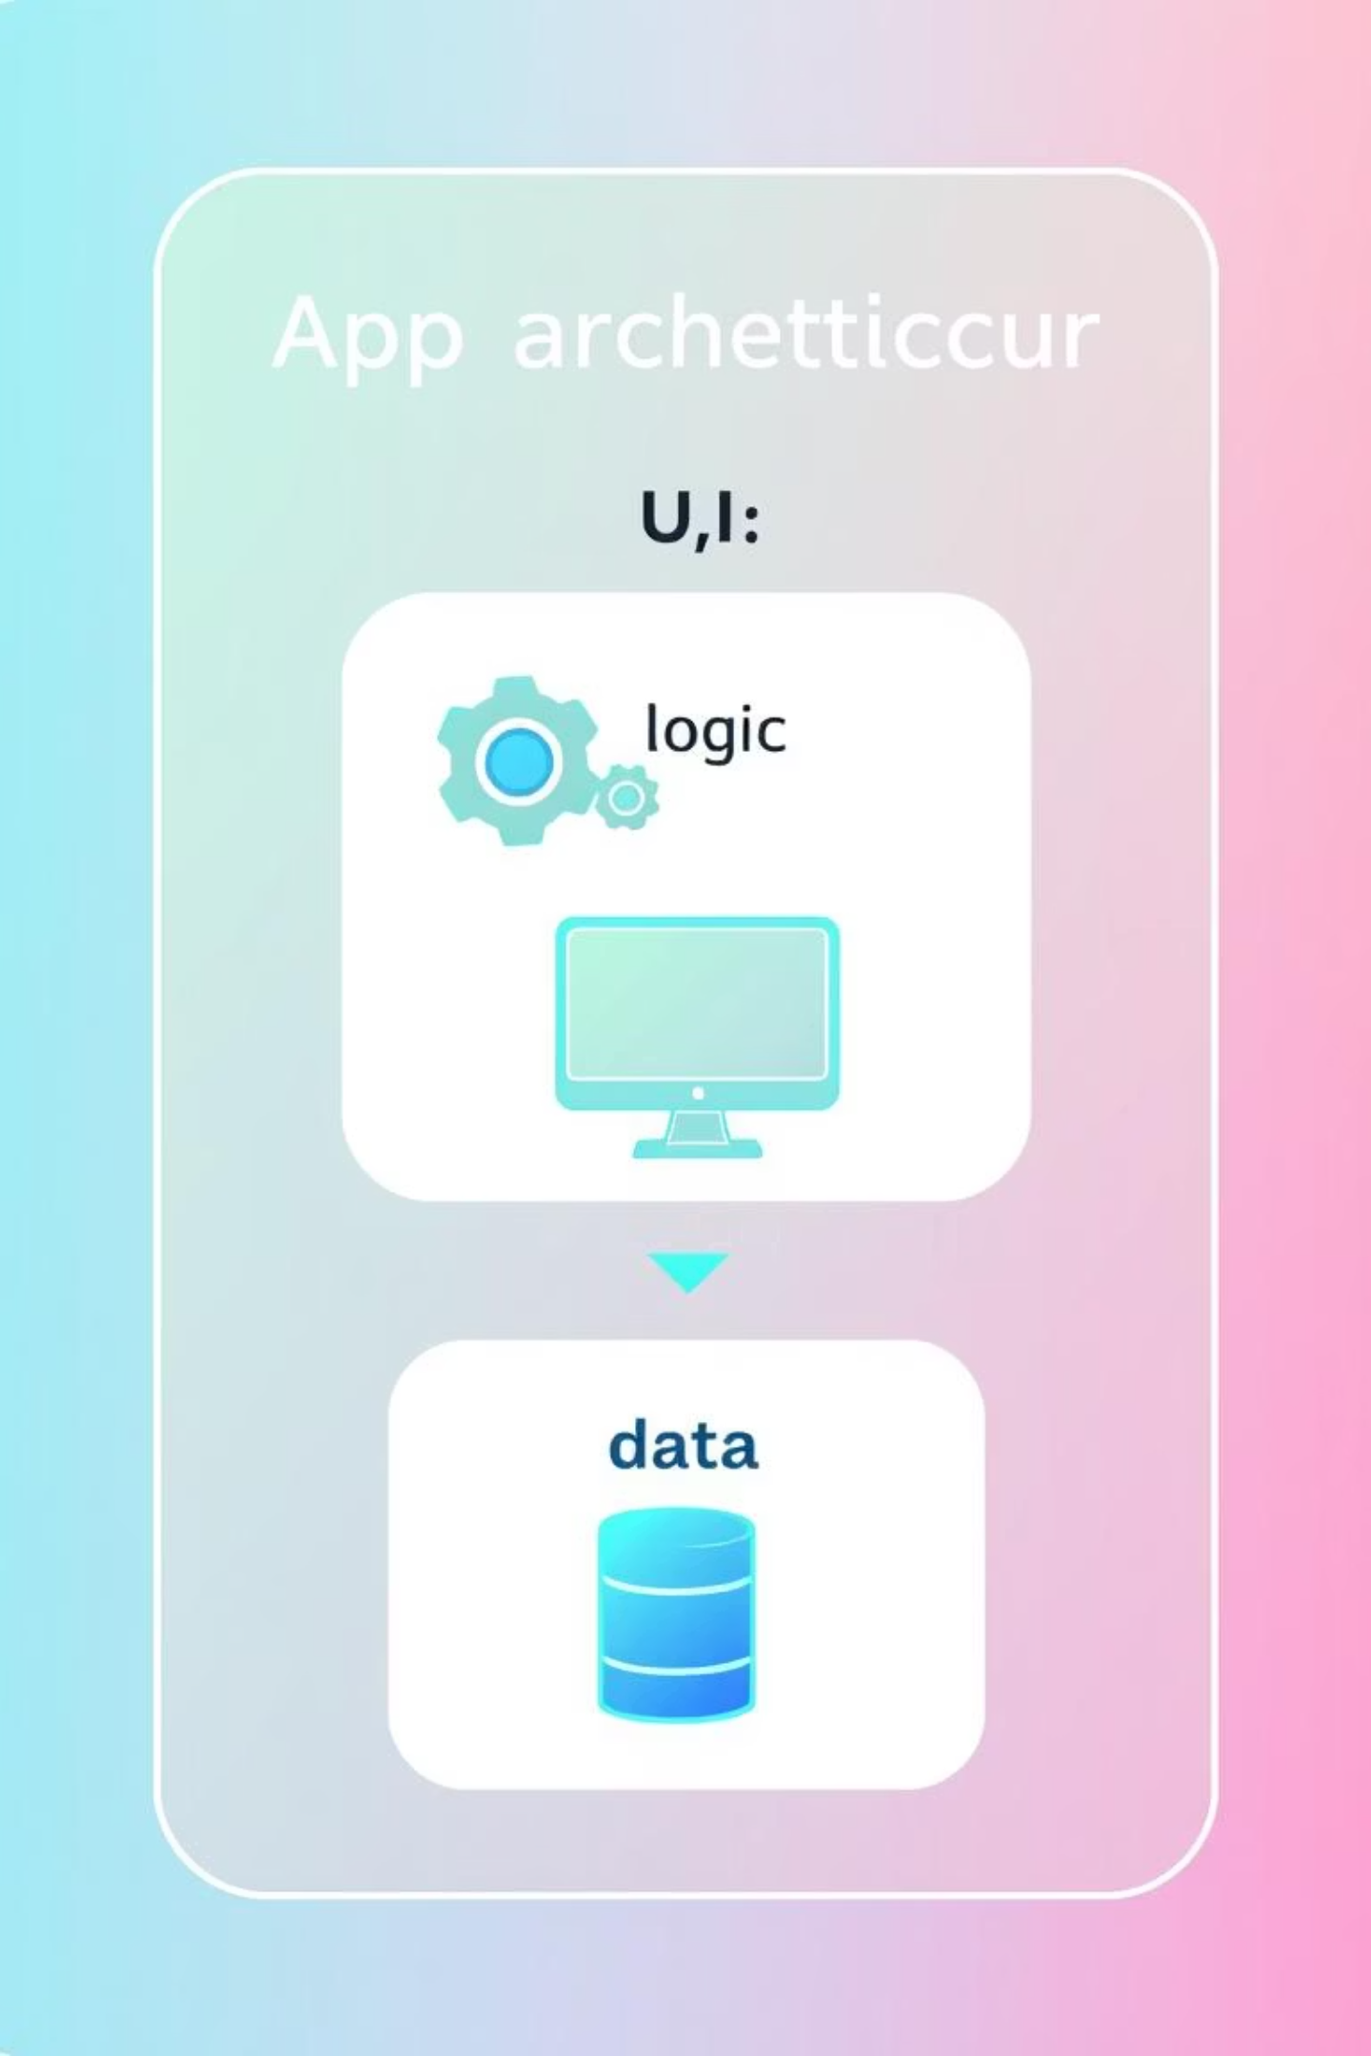




App Architecture
Modular Activities
Each feature has its own Activity class.
MVC-like Structure
Separates logic (Java), layout (XML), and data (SQLite).
Explicit Intents
Ensures smooth screen transitions.
SQLite Persistence
Data stored for offline access.

Slide 8
Database Design
SQLite serves as the database engine for this project. Key tables manage user information, appointments, lab cart items, and final orders.
Table Name
Description
users
Username, password, profile data
Helper classes handle all database operations. Data validation ensures clean entries during form submissions.
appointments
Doctor ID, date, patient ID
lab_cart
Tests added by user
orders
Finalized appointments, tests

Slide 9




Challenges Faced
RecyclerView Performance
Data Persistence
Optimising multiple RecyclerViews prevented lag. Efficient adapters were crucial.
Persisting data across sessions was vital. SharedPreferences and SQLite handled it.
UI Compatibility
Smooth Transitions
UI consistency across diverse devices. Extensive testing ensured broad compatibility.
Managing activity transitions. Explicit Intents provided seamless navigation.
Modular components and rigorous testing addressed these issues. Local data persistence was key.

Slide 10





Future Scope
The app currently operates offline. Future enhancements will extend its capabilities significantly.
Cloud Sync
Notifications
UPI Payments
Firebase for real-time backup.
Appointments and test results.
Integrate for test orders.
Doctor Portal
API Connectivity
For doctor appointment confirmation.
Dynamic doctor and hospital info.
These improvements will transform it into a full-fledged smart healthcare platform.

Slide 11
Team Member Contributions
Our team collaborated effectively to deliver this healthcare application. Each member played a crucial role in its development.
Team Member
Key Contribution
Miruthula S.K.
Led overall architecture and development.
Rohith S.
Designed UI/UX and implemented front-end.
Yaswanth Sai D. (22BCE1882)
Managed database design and backend logic.
Guduri Dhanush
Ensured security and data validation.
Madhav Aithagani
Handled data management and analytics.
D. Yaswanth Sai (22BCI0215)
Focused on testing and quality assurance.

Slide 12
Thank You!
Your time and attention are greatly appreciated.

